Slide 1


Blending your education

Slide 2
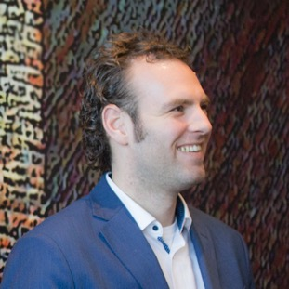
Wiebe Dijkstra
Blended Learning Developer
Teaching and Learning Services TUDelft

Slide 3
Goals
Explain the concept of Blended Learning
Develop a sequence of online and face-2-face learning activities

Slide 4
What
Why
Examples
Start

Slide 5
What
is blended learning?

Slide 6
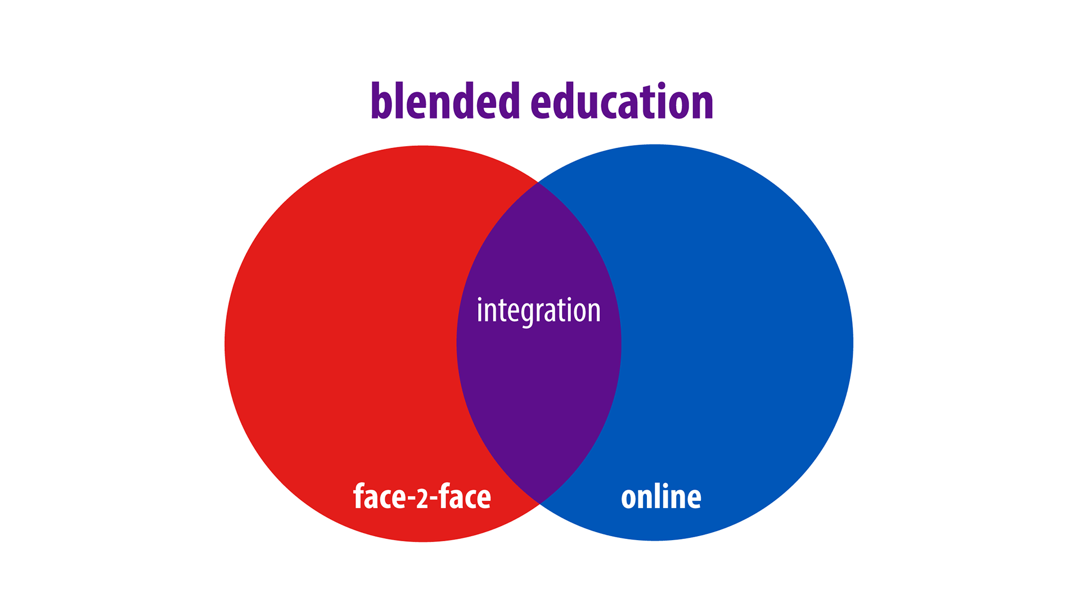
Notes:
The same definition, but visualized.
Examples of online learning activities
Examples of face to face learning activities
Examples of integration, and why that’s key.

Slide 7
Learning as a result of a deliberate, integrated combination of online and face-to-face learning activities.
The European Maturity Model for Blended Education
Notes:
Before we can answer that question we need to determine what BL is. This is a definition……
It’s the definition of the embed project we’re participating in. The goal is to create a maturity model for blended learning and education. So check it out.

Slide 8
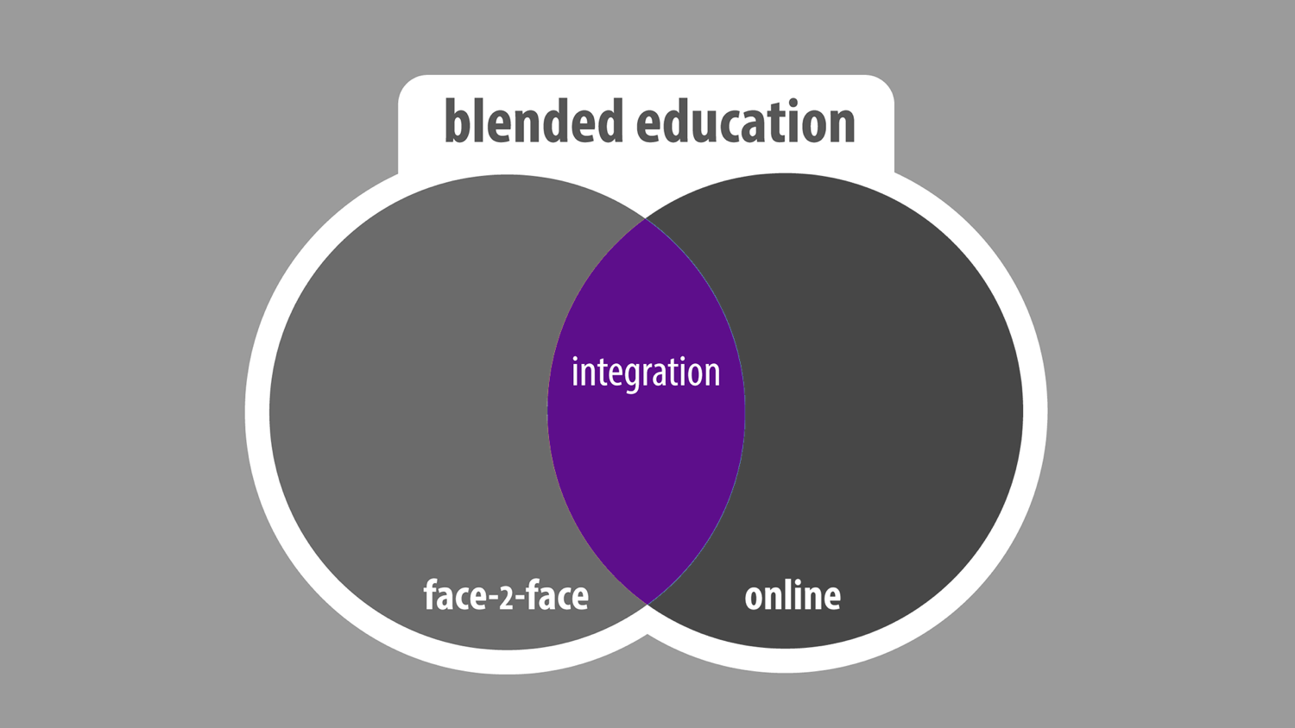
Notes:
Nadruk leggen op integratie. Dit is het belangrijkste om een goede blend te maken.

Slide 9






Face-2-face
Online
Teacher led
Self study
Synchronous
Asynchronous
Notes:
Definition?

Slide 10
How does it fit?

Slide 11
Objectives
Activities
Assessment

Slide 12
Create
Evaluate
Analyze
Apply
Understand
Remember

Slide 13
Objectives
Activities
Assessment

Slide 14


Formative
assessment
Summative
assessment

Slide 15
Objectives
Activities
Assessment

Slide 16


Online
Learning
Activities
Face-2-face
Learning
activities

Slide 17
Objectives
Activities
Assessment

Slide 18




Slide 19
Objectives
Activities
Assessment

Slide 20
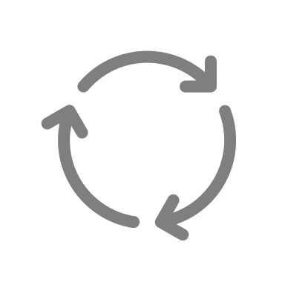

Objectives
Activities
Assessment

Slide 22
Why
would you blend?

Slide 23




More active
More flexible
More feedback
More effective & efficient

Slide 24








Evidence informed principles
Words
Prior
knowledge
Active
learning
Examples
Image +
Words
Feedback
Check
understanding
Assessment
for learning
Spaced
practice

Slide 25
Examples
of blended learning courses

Slide 26







Blended Learning Wave
Watch
video
Read
material
Calcu-
lations
Prepare
lecture
Online
Online Quiz
Discuss calculations
Discuss Quiz
Peer
Instruction
F2F
In-depth
Lecture
Notes:
Model for blended learning & learning activities
1. Online components
2. Face 2 face components
3. Time
4. Activities. In this case online activities. Students need to Watch, Read and do a quiz
5. Offline activities. They did the preparation at home. In the lecture they're going to discuss the quiz.
6. Go home, online activities
7. Next lecture, discussion & indepth lecture
8. Wave --> Activities follow upon each other. What they do at home/online is the input for the f2f meeting
This is called the wave,

Slide 27

PRIME
PRoject Innovation Mathematics Education
Service Education 1st and 2nd year Math courses
Team of teachers
Prepare, Participate, Practice

Slide 28


Prime
Watch
video
Interactive
exercises
Online
Pre lecture
exercise
Textbook
Assignments
Clicker
Questions
Textbook
Assignments
F2F
Lecture
Notes:
Model for blended learning & learning activities
1. Online components
2. Face 2 face components
3. Time
4. Activities. In this case online activities. Students need to Watch, Read and do a quiz
5. Offline activities. They did the preparation at home. In the lecture they're going to discuss the quiz.
6. Go home, online activities
7. Next lecture, discussion & indepth lecture
8. Wave --> Activities follow upon each other. What they do at home/online is the input for the f2f meeting
This is called the wave,

Slide 29
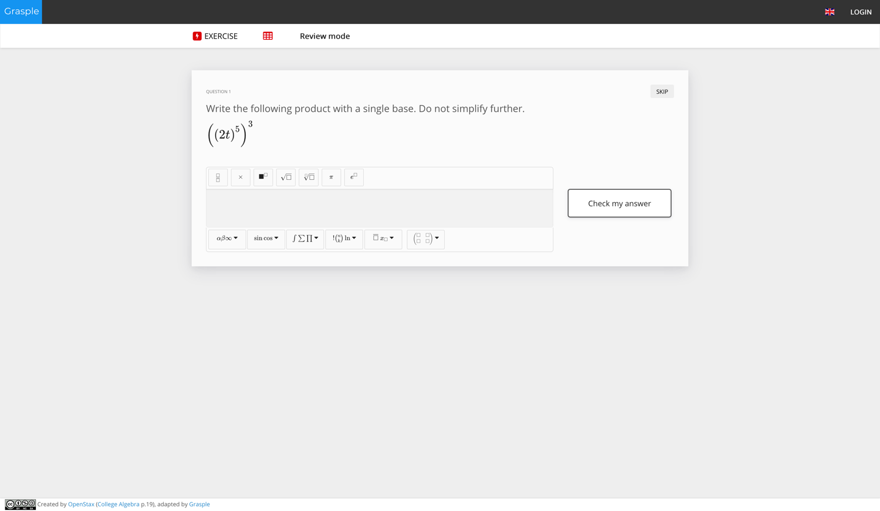
PRIME
Notes:
This material is freely available on internet.
You can use this.
We can help you find materials for your own course.

Slide 30
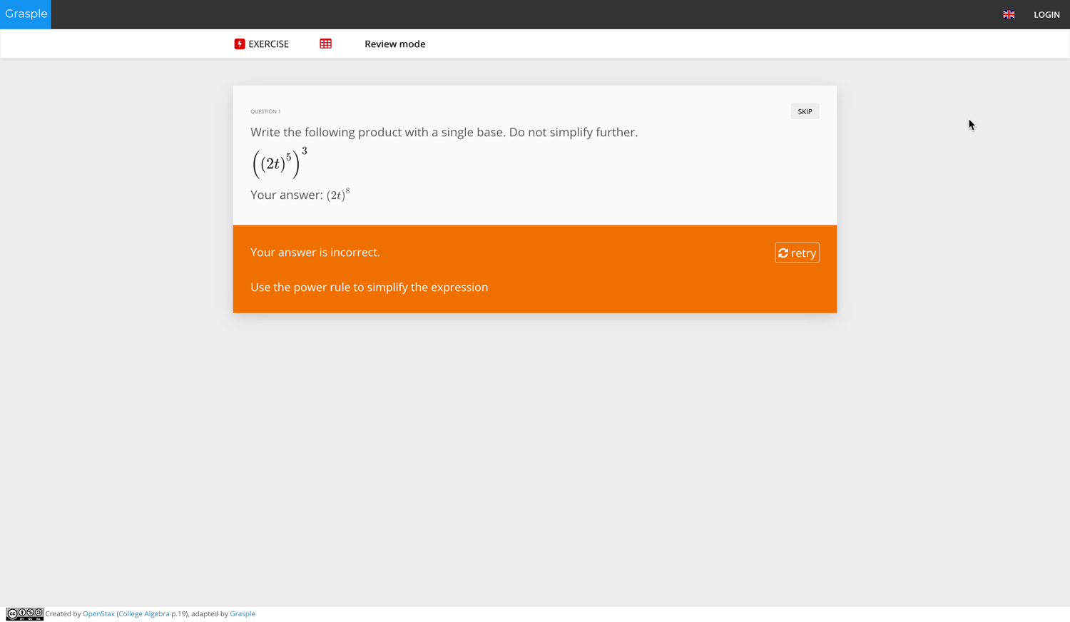
PRIME
Notes:
This material is freely available on internet.
You can use this.
We can help you find materials for your own course.

Slide 31
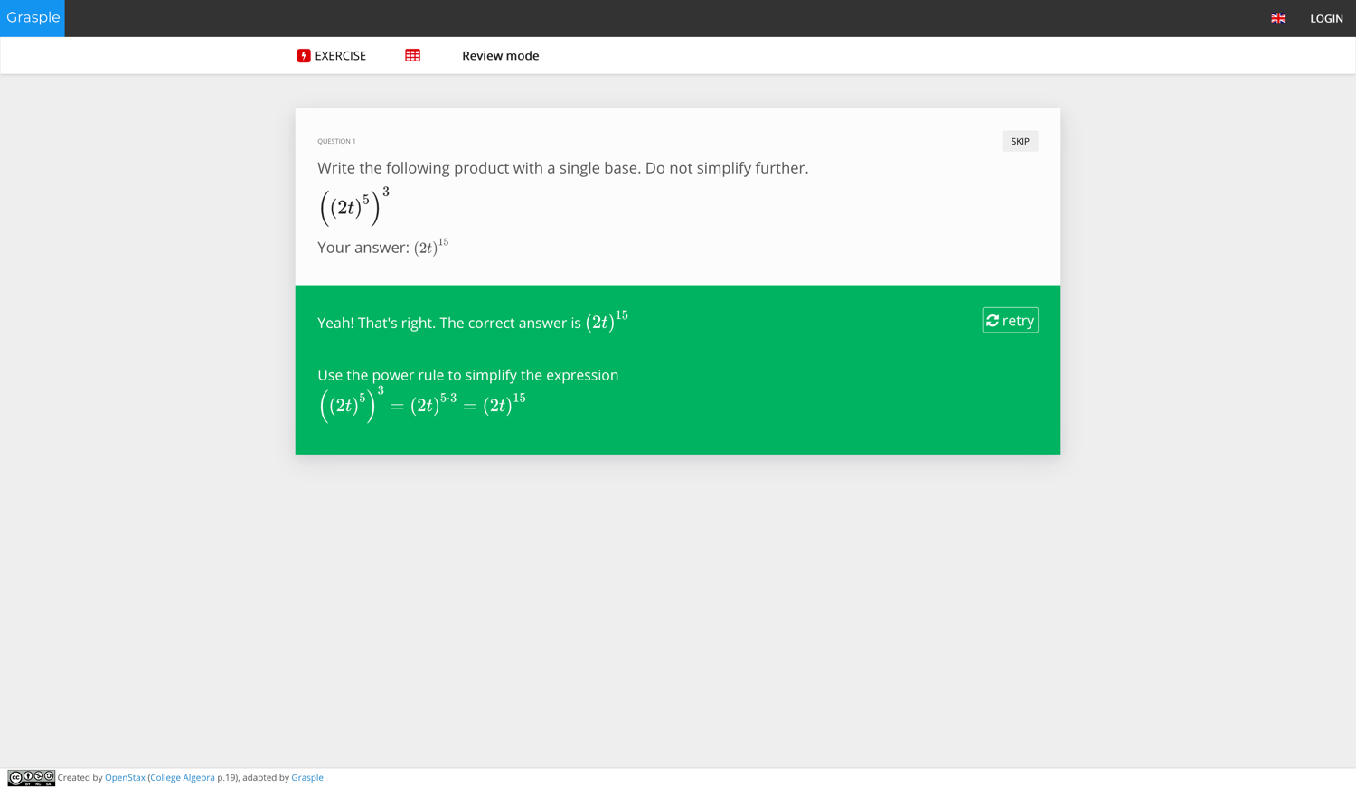
PRIME
Notes:
This material is freely available on internet.
You can use this.
We can help you find materials for your own course.

Slide 32

Railway Engineering
Redesign 5 master course
All blended
Photo by Johannes Plenio on Unsplash

Slide 33


Railway Engineering
Watch
video
Read
material
Calcu-
lations
Prepare
lecture
Online
Online Quiz
Discuss calculations
Discuss Quiz
Peer
Instruction
F2F
In-depth
Lecture
Notes:
Model for blended learning & learning activities
1. Online components
2. Face 2 face components
3. Time
4. Activities. In this case online activities. Students need to Watch, Read and do a quiz
5. Offline activities. They did the preparation at home. In the lecture they're going to discuss the quiz.
6. Go home, online activities
7. Next lecture, discussion & indepth lecture
8. Wave --> Activities follow upon each other. What they do at home/online is the input for the f2f meeting
This is called the wave,

Slide 34



Peer Instruction
ALL
SOME
NONE
Notes:
Teacher asks a question
Students vote individualy
Teachers sees the result, but doesn’t share it with the students
If all students have the right answer: shortly explain and go to the next activity
If none of the students have the right answer: revisit the concept
If some of the students have the right answer:
Let the students discuss with their neighbors. They need to convince them of their answer
Students need to vote again
The results are usually better. Explain the right answer and go to the next activity

Slide 35
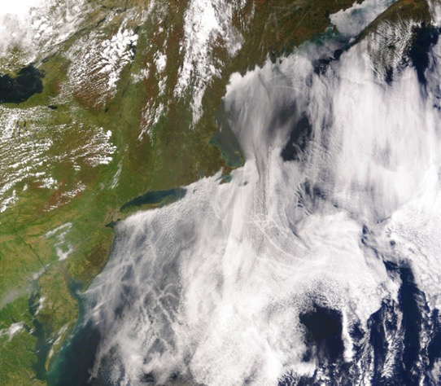
Climate Physics
Flipped course
Existing MOOC materials from:
Own MOOC ‘Water and Climate’
MIT MOOC ‘Global warming science
"Satellite image of ship tracks, clouds created by the exhaust of ship smokestacks." by Liam Gumley, NASA is in the Public Domain, CC0

Slide 36

Climate Physics
Watch
video
Watch
video
Online
Discuss Cases
Lab
Work
Discuss Cases
Clicker
Questions
F2F
Clicker
Questions
Notes:
Model for blended learning & learning activities
1. Online components
2. Face 2 face components
3. Time
4. Activities. In this case online activities. Students need to Watch, Read and do a quiz
5. Offline activities. They did the preparation at home. In the lecture they're going to discuss the quiz.
6. Go home, online activities
7. Next lecture, discussion & indepth lecture
8. Wave --> Activities follow upon each other. What they do at home/online is the input for the f2f meeting
This is called the wave,

Slide 37
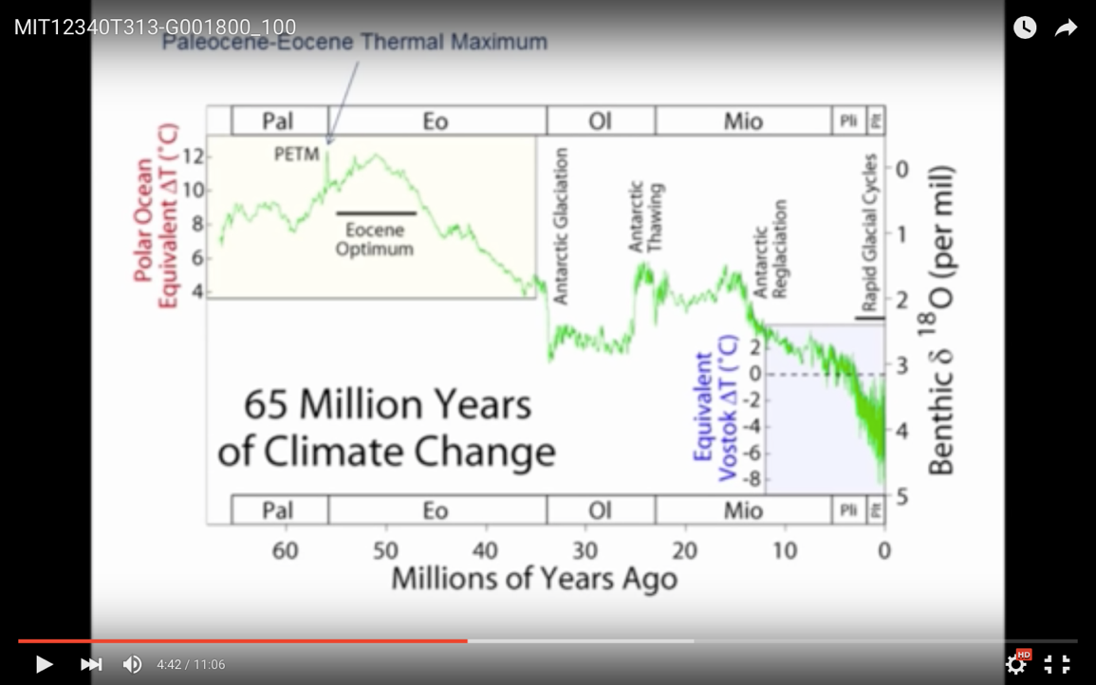
Notes:
This material is freely available on internet.
You can use this.
We can help you find materials for your own course.

Slide 38
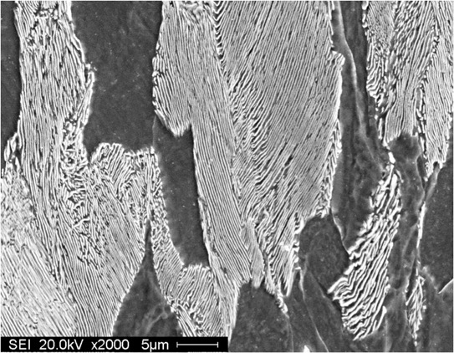
Material Sciences
Online exam questions
Condensed Lecture
Problem solving
"Microstructure of pearlite" by Michelshock is in the Public Domain, CC0

Slide 39


Climate Physics
Bonus
materials
Read
book
Online exams
Online
Old
slides
Textbook
assignments
Summaries
Lecture
recordings
Condensed lecture
Discuss Cases
F2F
Notes:
Model for blended learning & learning activities
1. Online components
2. Face 2 face components
3. Time
4. Activities. In this case online activities. Students need to Watch, Read and do a quiz
5. Offline activities. They did the preparation at home. In the lecture they're going to discuss the quiz.
6. Go home, online activities
7. Next lecture, discussion & indepth lecture
8. Wave --> Activities follow upon each other. What they do at home/online is the input for the f2f meeting
This is called the wave,

Slide 40
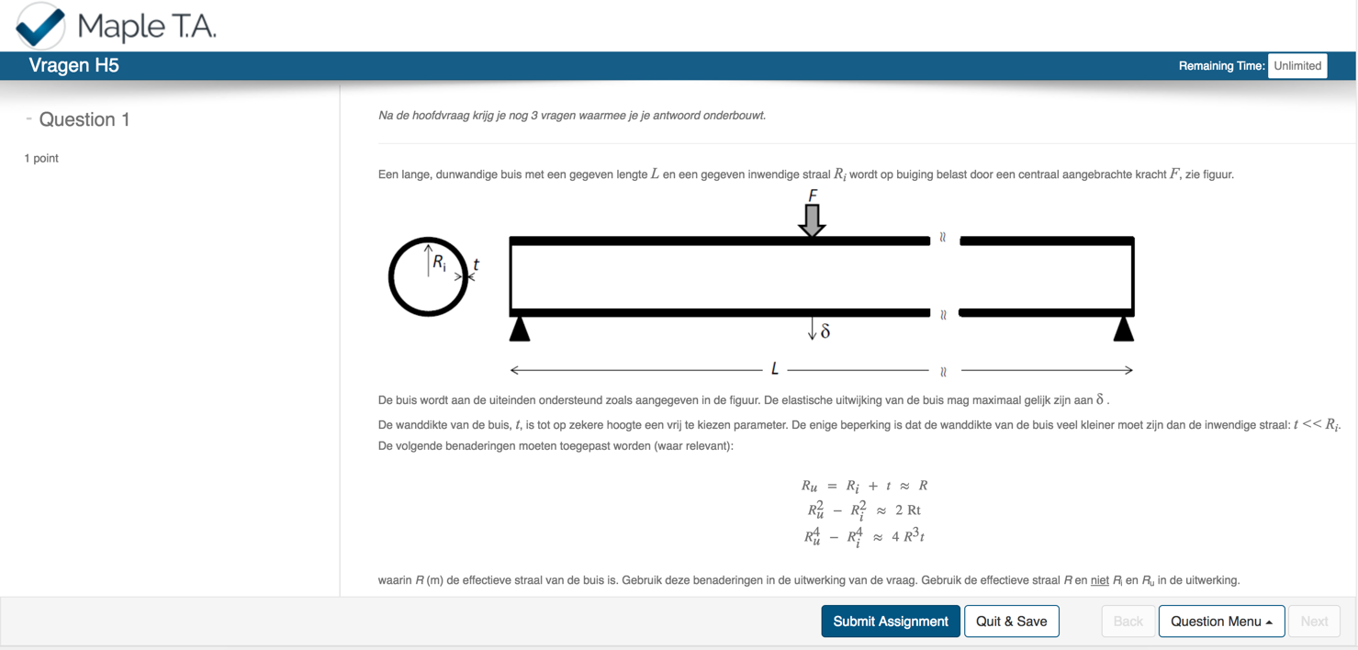


Slide 42
Start
with your blended course

Slide 43














Video
Discussion board
Assignments
Interactive courseware
Peer
feedback
Concept Map
Online
Read a chapter
Quiz in the LMS
Online
brainstorm
Collaborative writing
(Online) Portfolio
Student generated content
Explanation
Labwork
(Textbook) assignments
Clickers
Student presentations
Game
F2F
Peer instruction
Guest lecture
Fieldtrip
Modeling
Face-2-face discussion
One minute paper

Slide 44


How can you start?
Get a sheet of paper and some post-its
(or a digital canvas)
Create your blended learning wave

Slide 45





Design questions
What is the added value of the teacher?
How much hours can students spend per week?
How (often) do you communicate with your students?
How do you use online activities as input?
How can you integrate feedback?

Slide 47

Notes:
I’d like to end with a quote from Salman Khan (Khan Academy)
“The most valuable time is the time with our students”
Let’s try to use it as good as possible.
Thank You

Slide 48


w.p.dijkstra@tudelft.nl
@wpdijkstra

